Slide 1
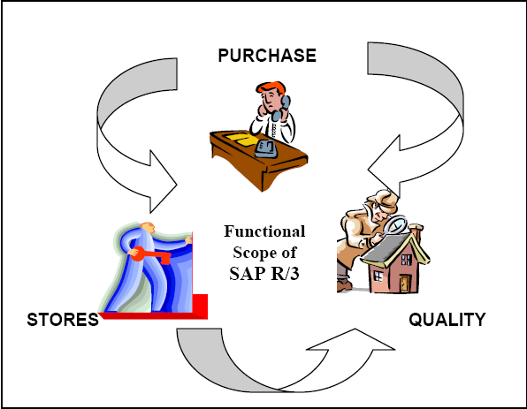
MM0004 – Purchasing
Notes:
This In-house course is developed to meet the needs of SAP R/3 Consultants working at Capgemini. This course is designed to present a high level view of Materials Management Organization Structure and to provide the Consultants with basic information about how to use this Functionality.
More in-depth courses have been developed to train Consultants in specific areas discussed during this course.
Your comments at the conclusion of this training session are appreciated and will help us better tailor future courses to meet your training needs.

Slide 2
MM0004 – Purchasing
PrepareMe
1
2
TellMe
3
ShowMe
4
LetMe
5
HelpMe

Slide 3
MM0004 – Purchasing
PrepareMev
1
2
TellMe
3
ShowMe
4
LetMe
5
HelpMe

Slide 4

PrepareMe
Purpose
A way to reduce expediting , and concentrate on sourcing and negotiating
Improved request control and approval
Acquire materials and services as economically as possible
To select the vendor to be used, considering delivered cost, quality required, vendor capability, vendor service record and delivery dates
Control the source determination process with the aid of the source list

Slide 5
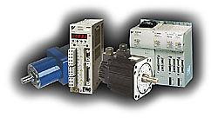
Use
Potential benefits offered by procurement function
Procurement Functions can bring your enterprise many benefits. It offers you many advantages over manual purchasing systems and stand-alone solutions.
Reduces clerical effort
Procurement Functions allow you to reduce the time you spend on clerical tasks ,such as looking for copies of orders, or trying to find out which orders have been received. Many of the procurement tasks can be carried out automatically with Procurement Functions.
Allows more time for negotiation
Procurement Functions gives you more time for planning and analyzing the supply situation, negotiating prices with your suppliers, and for passing on information about changes in requirements and the servicing of deliveries. You have more time to get the best deal for your enterprise.
Meets your needs
Procurement Functions addresses standard procurement procedures. Every enterprise has its own procurement requirements. Because of the open and flexible structure provided by the use of relational databases, you can add your own routines or those provided by other manufacturers to meet the individual needs of your enterprise. You can ensure the changing requirements of your enterprise are always met.
Integrates your information
Because Procurement Functions makes use of relational databases, data is entered once only and stored in common databases. This ensures that the same up-to-date procurement information is available to everyone who needs it. This is invaluable for enterprises that operate a just-in-time ordering policy.

Slide 6
Challenges
What information Is included
What is to be purchased?
How much is to be purchased?
How much does it cost?
Who’s paying for it?
When is it needed?
Where does it go when it arrives?
What additional information is needed, relative to this purchase?
What is to be purchased
Determine if it is a service or material
If It is service what activities are to be included in the service
How much is to be purchased
Quantity to be purchased with appropriate Unit of measure
Who is paying for it?
What type of purchase is it?
What department is paying for it?
What fund is providing the money?
This information also becomes a factor in determining who needs to approve the purchase request.
How much Does it cost
What is the unit price of the item?
This, together with the quantity requested, will be extended to a total cost of the requisition line item.
The total cost of the line item will be a factor in determining who needs to approve the purchase request
When it is needed?
An expected delivery date must be Determined.
This may be the date agreed to by the supplier at the time contact was made by the requisitioner or a requested delivery date with no contact with the supplier.
Where does it go when it arrives?
If the material is non-inventory, to what building/room number should it be delivered?.

Slide 7
MM0004 – Purchasing
PrepareMev
1
2
TellMe
3
ShowMe
4
LetMe
5
HelpMe

Slide 8
Overview of Purchasing
BASIC DATA
SD
Third-party
order
Material Special stock Batch
Vendor/one-time customer
Purchasing info record
Service specifications
Workflow
Optical archive
Texts Mail Communication
Classification
Documents
Conditions
PURCHASING
Purchase requisition
PP
Requirements
MRP
Direct requisition
Release procedures
PM
Service /
spare parts
QM
Inspection lot
Purchasing information system
Vendor evaluation
RFQ/Quotation
Material/service
Price comparisons
Price comparison list
FI
G/L accounts
Cash management
and forecast
AM
Fixed assets
Purchasing
Purchase orders
Outline agreements
Scheduling agreements
CO
Cost center / Budget
PS
Project
Notes:
The above structure deals with the concept of organizational levels in Purchasing necessary to replicate an
enterprise structure in the SAP system. It also introduces a simple procurement process with its elements like RFQ, purchase order etc integrated with Master Data and the other cross-functional modules.

Slide 9
Procurement Cycle
Purch. req.
Manual
Creation
MRP
1
Determination of Requirements
Planned
Order
2
Source Determination
3
Vendor Selection
4
Purchase order processing
5
Purchase order monitoring
Update Financial
6
Good Receipt
7
Invoice Verification
8
Payment Processing
Notes:
Determination of requirements: The responsible user department can manually pass a requirement for materials to the Purchasing department via a purchase requisition. If you have set a MRP procedure for a material in the material master,the SAP system automatically generates a purchase requisition.
Determination of source of supply: As a purchaser, you are supported during determination of possible sources of supply. You can use determination of the source of supply to create requests for quotation (RFQs) and then enter the quotations. In addition, you can refer to purchase orders, contracts and conditionsthat already exist in the system.
Vendor selection: The system simplifies the selection of vendors by making price comparisons between the various quotations. It automatically sends rejection letters.
Purchase order handling: Similar to purchase requisitions, you can create purchase orders manually or have them created automatically by the system.When you create purchase orders, you can copy data from other documents,such as purchase requisitions or quotations, to reduce the amount of entry work required. You also have the option of working with outline agreements.
Purchase order monitoring: You can monitor the processing status of the purchase orders in the system. You can also determine, for example, whether a delivery or an invoice for a purchase order item has been entered. You can remind the vendors of outstanding deliveries.
Goods receipt: When you enter incoming deliveries in the system, you refer tothe relevant purchase order. The amount of entry work is therefore minimized,and you can check whether the delivered goods and quantities match the purchase order. The system also updates the purchase order history of the purchase order.
Invoice verification: When entering invoices, you refer to the previous purchase order or delivery so you can check the calculations and the general accuracy of the invoice. The availability of the purchase order and goods receipt data enables you to refer to the quantity and price variances.
Payment processing: The payment program authorizes payment to the creditor liabilities. Financial Accounting executes this program regularly.

Slide 10
Organizational Elements
Company Code
Plant
Purchasing Org
Purchasing group
Storage location
Storage bin
Notes:
In the SAP system, organizational levels are structures that represent the legal or organizational views of a company. The determination of the organizational levels is an important work step in the project and an essential prerequisite for all subsequent activities.

Slide 11
Purchasing – Org Structure
Plant
Purchase
Org
Storage Loc
SAP
SAP
SAP
PURCHASING
INVENTORY
Business Functions
ENTERPRISE
Client
Notes:
The purchasing organization is an organizational unit within logistics that subdivides the enterprise according to the purchasing requirements. A purchasing organization procures materials or services, negotiates conditions of purchase with vendors, and assumes responsibility for these transactions. You can incorporate purchasing into the company structure by assigning the purchasing organization to a company code and to plants.

Slide 12
Business Objects
Purchase requisition
RFQ
Vendor quotation
Purchase order

Slide 13
Purchase Requisition Processing
Create
purchase
requisition
Determine source of supply
Release (optional)
Allocate vendor and process
Purchase Requisition
10
20
30
Contract
Requisition
RFQ
Purchase Order
o.k.
Vendor
Manual or Automatic
In the SAP system, you can set up approval procedures for purchase requisitions and external purchasing documents (POs, contracts, scheduling agreements, and
RFQs).

Slide 14
Purchase Requisition - Release
A Purchasing Requisition that is subject to a release procedure needs to be released by the required releasing authority.
The release procedure is semi-automated but it does require that all persons who are responsible for approving the requisitions to understand how to release them in a timely manner so that goods and services can be procured efficiently.
Daily Activities for all approval authorities
List Display of Purchasing Requisitions
Perform Individual release (line item wise) or Collective release (Entire document)

Slide 15
RFQ/Quotation Processing
Create
RFQ
Maintain Quote
Price Comparision
Create Info record
Request for Quotation
10
20
30
Maintain
Quotation
Purchase Order

Slide 16
Quotation Processing
1
Enter Price & Conditions
Vendor A
Vendor B
Vendor C
Quotation for RFQ 1
Quotation for RFQ 2
Quotation for RFQ 3
Item 10
Item 10
Item 10
Gross Price: 400/t
Gross Price: 400/t
Gross Price: 400/t
Discount: $ 50
Discount: $ 20
Discount: $ 40
2
Enter Price & Conditions
Steel 2t
Price
350/t
480/t
520/t
450/t
Quote 1
Quote2
Quote 3
Mean Value Quote
3
For E.g Create inforecord or reject Quotation
Purchase Order
Price
Rejection
Market Price
Info record

Slide 17
Purchase Order Processing
Purchase
Requisition
Purchase Order
10
20
30
Vendor
Manual
Another plant
Material
Master
RFQ
Data-entry time can be minimized by creating purchase order items with reference to an existing purchase order, purchase requisition, quotation or contract.
A purchase order can also be created without reference to preceding documents in the system.
Notes:
When you enter the purchase order data, the system suggests default values. For example, it suggests the ordering address, as well as the terms of payment and freight (incoterms) from the vendor master record. If a material master record exists, the material short text and the material group is transferred automatically. If a purchasing info record already exists in the system, a price can be proposed for the purchase order.
In addition to the purchasing data (in material master), you can maintain partner roles in the vendor master record (these may also be referred to as partner functions). Partner roles are roles that your business partners may assume (such as ordering address, goods supplier, or invoicing party), and are automatically taken into account when you create a purchase order, for example.

Slide 18
Purchase order processing
Document no
Org data
Condition
Status
Purchase Ord
Header
Item
10 __________________
20 __________________
30 __________________
Material No
Material Desc.
Quantity
Price
Plant
In a PO, materials or services can be procured for all the Plants attached to the Purchasing Org. for which PO is created
Standard PO, Subcontracting PO, Consignment PO, STO and Third Party PO are different types of PO and these are differentiated with Document Type function.
Document Overview screen PO, displays different Purchasing documents like RFQ, PR, other PO’s.

Slide 19
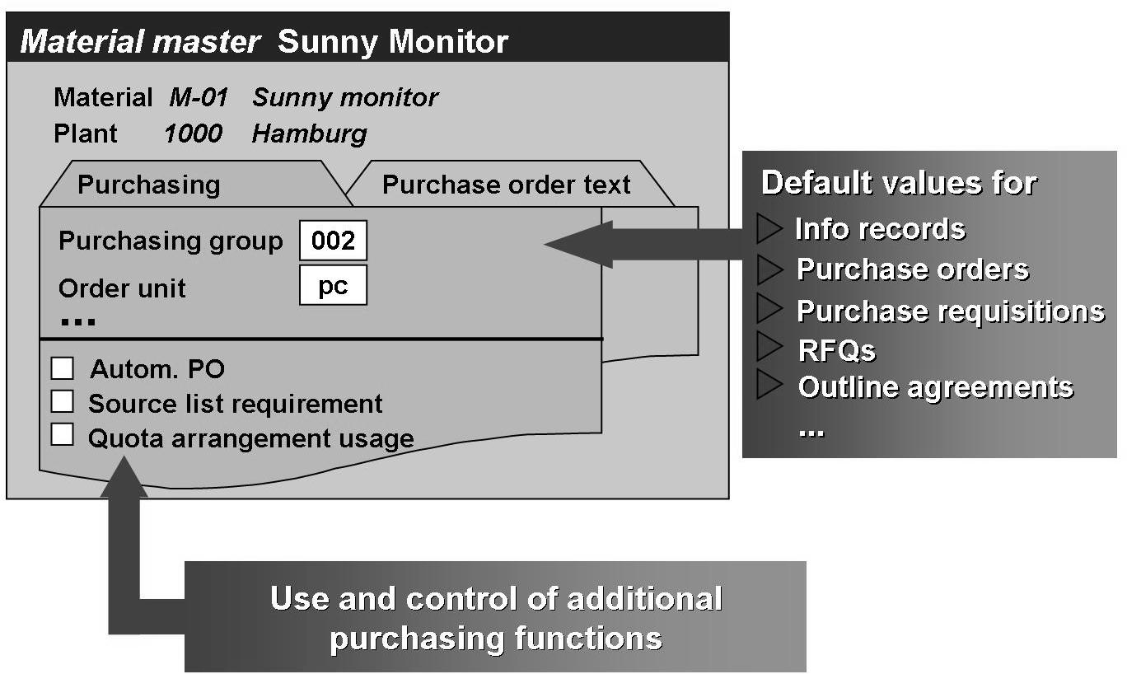
Master Records for Purchasing
The data on a material is kept at different organizational levels. From thePurchasing viewpoint, a material master record has the organizational levels client and plant.
Plant level contains the data relevant to the individual branches, plants, or departments within a certain company. The data specific to Purchasing is usually stored at this level. Examples of this data are the purchasing group, the purchase order unit, and various control indicators (such as automatic purchase order source list requirement, or quota arrangement usage).
Client level contains the data applicable to all individual group companies,all plants, and all warehouses/stores belonging to an enterprise (corporate group).
Notes:
This data structure facilitates the organization of material-related information within the whole enterprise. It prevents redundancy in the storage of material data if the same material is used in more than one plant or stored at more than one storage location.

Slide 20
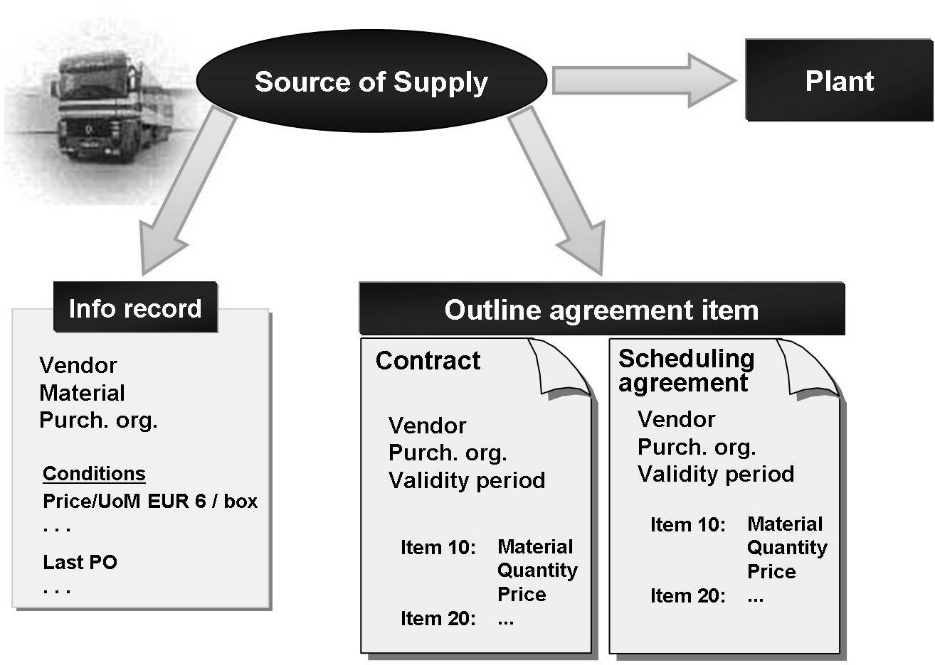
Purchasing Info Records for Purchasing
The purchasing information record (or info record for short) is a source of
information for the purchasing department.
It contains data on a certain material and the supplier of this material.
It can contain data such as the vendor's current price for the material. The prices and other data stored in the info record are used as default values in documents such as purchase orders.
Notes:
There are two types of info record:
. Info records with material master record (for example, stock material)
These reflect the relationship between a material or service with a material master record and a vendor.
. Info records without material master record (for example, consumable material)
These reflect the relationship between a material or service without a material master record and a vendor.
The system suggests info records for material groups as sources when you manually create a requisition item without a material master record.

Slide 21
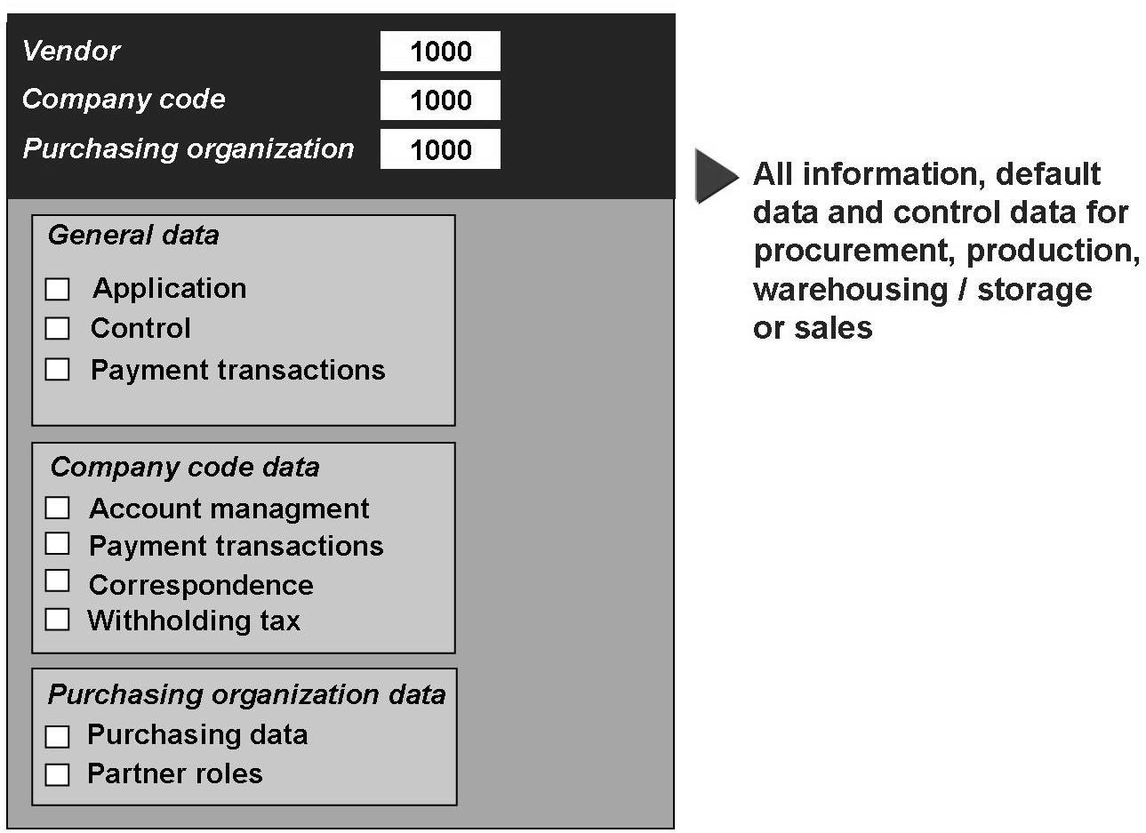
Vendor Master Records for Purchasing
The vendor master database contains information on an enterprise's vendors.
This information is stored in individual vendor master records. In addition to the vendor's name and address, a vendor master record contains data such as:
The currency used for transactions with the vendor
Terms of payment
Names of important contact persons (sales staff)
Notes:
The vendor master record comprises the following three areas:
General data
This is data that applies equally to every company code and every purchasing organization within your enterprise (for example, address, telephone numbers, or language of communication with vendor).
Company code data
This is data that is kept at company-code level (such as data on payment transactions, or reconciliation account number).
Purchasing data
This is data that is important for purchasing and is kept for each purchasing organization (for example, contact person, and terms of delivery).

Slide 22
Outline Agreement
Contract
Quantity
Contract
Validity Period
Material
Quantity
Value
Contract
Release ord
Material
Quantity
Value
Centrally Agreed
Distributed
Schedule Agreement
Scheduling
Agreement
Schedule
Agreement
Material
Quantity
Value
Schedule lines
Quantity
Delivery Date
Schedule
Agreement with
Release
JIT
Fore
cast
Outline agreement items
An outline purchase agreement is a longer-term arrangement between a purchasing organization and a vendor covering the supply of materials or the provision of services subject to predetermined conditions. These apply for a predefined period and a predefined total purchase quantity or certain total purchase value.
The two types of outline agreement are contracts and scheduling agreements.
Contracts for Material Group
The contract-specific item categories M (material unknown) and W (material
group) are available to represent contractual agreements for groups of materials.
Notes:
There are two key differences in the use of these two agreement types:
. The volume of documents –
In the case of the contract, as a rule, you create a new purchase order in the system each time you release goods or services against the contract. With the scheduling agreement, on the other hand, there is only one further document apart from the agreement document; this is the delivery schedule, which is continually extended as new requirement quantities and delivery dates are added.
. Use in automatic materials planning-
Requirements planning can be set up in such a way that the contract item is automatically assigned to a requisition item as the source of supply. However, this requisition must subsequently be converted into a purchase
order (contract release order). In the case of the scheduling agreement, it is possible to directly generate scheduling agreement delivery schedules from the planning run, thus removing the need for any further processing time in the purchasing department.
The item categories M and W are intended for the entry of contract items without specification of the material.
Item category M
Recommended for similar materials of the same price. These can be materials with different material numbers or materials without material master records.
Example of use of item category M:
You have set up a contract with your vendor covering various types of writing paper (lined, squared, blank, two-/four-hole prepunched, etc.). The different types of paper have the same weight, the same quality, and the same price. When entering this contract item of category M, you enter the short description, material group, target quantity, unit of measure, and price, but no material number. The short description must then be entered in the contract release order (for example, lined, two-hole prepunched).
Item category W
Recommended for materials belonging to the same material group but with different prices. Item category W can only be used in value contracts.
Example of use of item category W:
You have set up a contract with your vendor for various types of cable. The contract is to cover all types of cable included in the vendor's price list. However, the exact type is only determined when a purchase order is created for a certain cable. Instead of creating one contract item for each type of cable in the vendor's
assortment, you could enter item category W and the appropriate material group (for example, cable).

Slide 23

Issuing Messages
Purchasing doc
Printer
EDI
FAX
Telex
Teletex
Print Out | Delivery Schedule | Expeditor/Reminder | Order Acknowledgment Expeditor

Slide 24
Name of the Functionality
PrepareMe
1
2
TellMe
3
ShowMe
4
LetMe
5
HelpMe

Slide 25
ShowMe
Agenda
Purchase requisition
RFQ
Vendor quotation
Purchase order

Slide 26
Purchase Requisition
1
Default data for line items
Delivery dates, purchasing groups, plant, etc.
2
Maintain line item data on overview screen Materials, quantities, delivery dates, purchasing group, etc.
3
Maintain account assignment (if required)
Cost center, G/L accounts,
asset number, etc.
4
Check data
Save

Slide 27
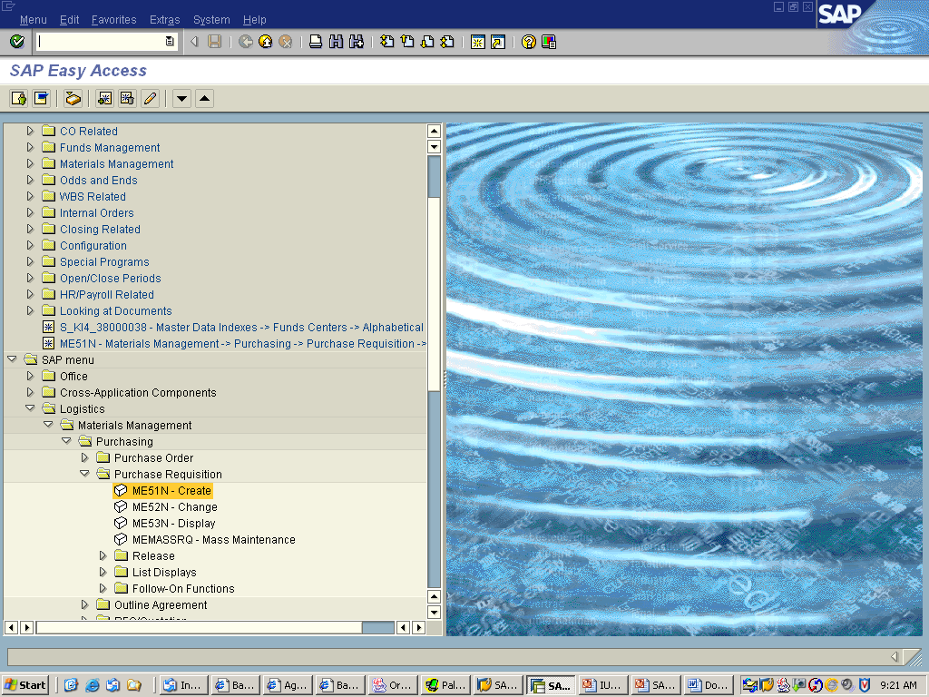
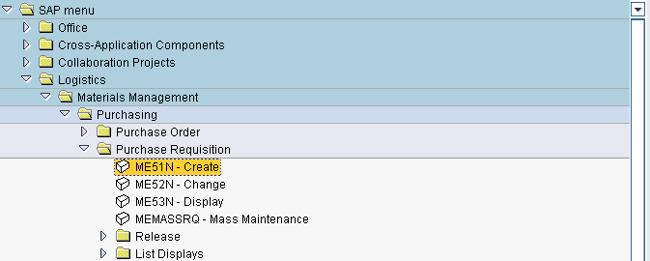
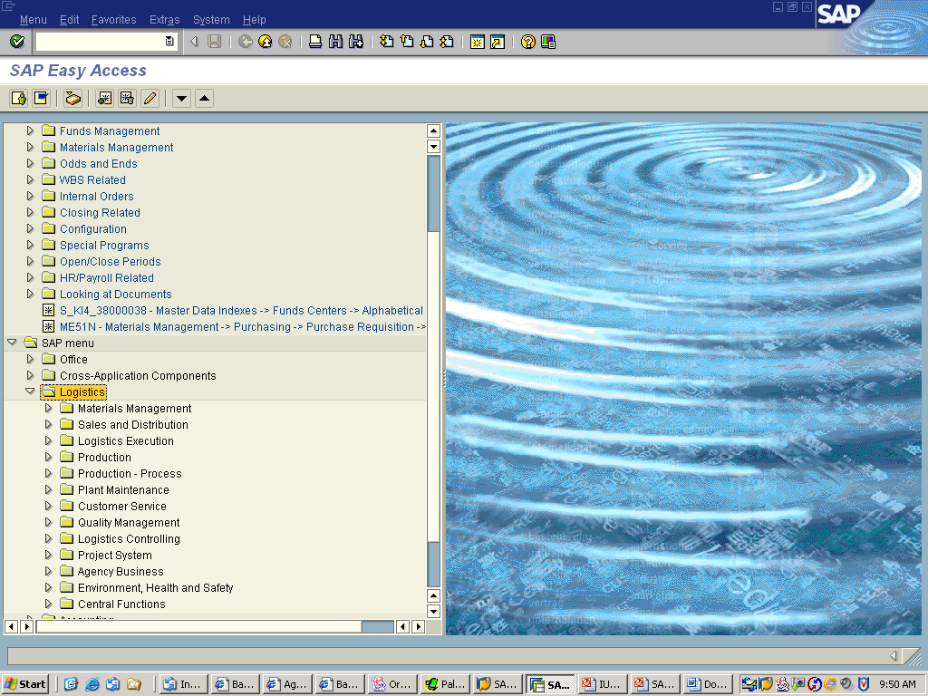
Purchase requisition
2. Click on the Materials Management arrow button.
1. Click on the Logistics arrow button.
Note: When clicked the arrow turns downward.
3. Click on the Purchasing arrow button.
4. Click on the Purchase Requisition arrow button.
5. Double click on the ME51N – Create Line.
Notes:
Purchase Requisition is an internal document either created manually or automatically through MRP. It is just a notification of requirement of certain qty of material within a specified period of time.
Purchase Requisition can be converted to a RFQ, PO or an outline agreement.
PR can be for various procurement types like, standard, subcontracting, stock transfer, consignment, etc.
Vendors are assigned to PR before they are further processed.
the Purchasing - for Purchase requisition menu, do the following:
...
Log on to the system. The SAP Menu appears.
Choose Logistics -> Materials management - >Purchasing -> Purchase requisition , to access Purchase requisition.

Slide 28
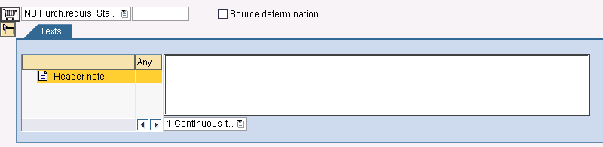
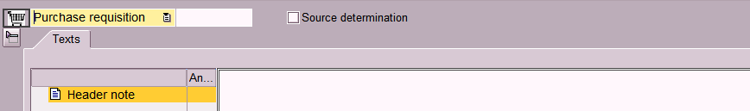
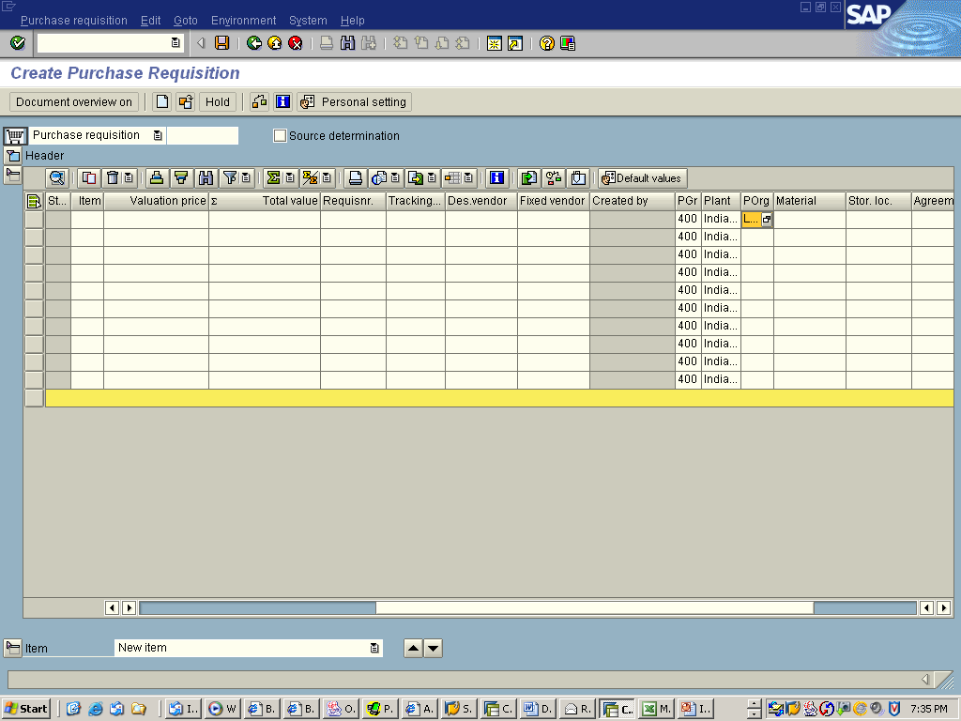
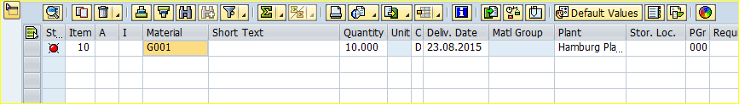
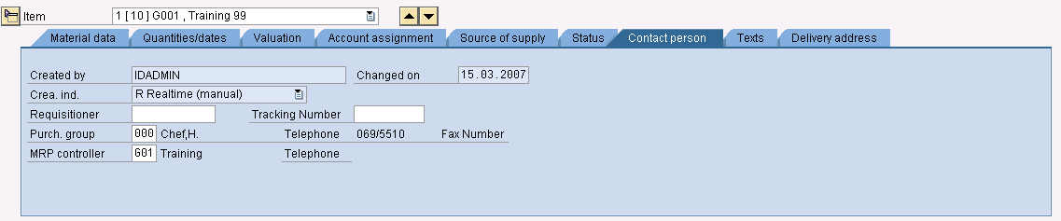
Purchase requisition
Header
Note: The Display Icon will display or hide text, overview, and detail lines.
Opened Closed
Item Overview
Item detail
Notes:
Each purchasing document is subdivided into two main areas: the header and individual items. Each document will contain a header and can contain several items.
The header contains information relevant to the whole document . The items specify the materials or services to be procured. For example, information about the vendor and the document number is contained in the document header, and the material description and the order quantity are specified in each item.
The additional data provides extra information about the item, and has no direct connection with the item procurement data. Additional data includes, for example, account assignment data (such as cost center and G/L account).

Slide 29
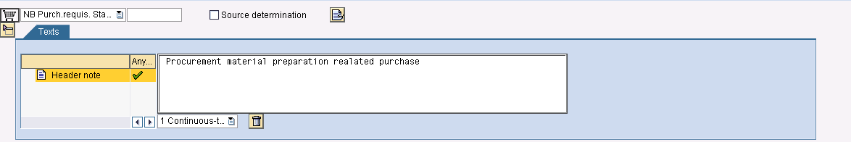
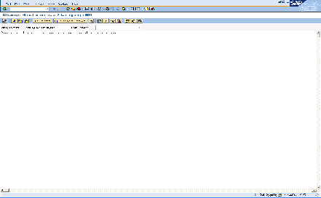
Purchase requisition
No Action Required – Automatically fills in.
Purchase requisition document type to choose
1. Move Cursor (Pointer) inside the Header Note Box. Double click the left mouse button.
Notes:
The requisitioner can enter internal header memos providing subsequent processors with information applicable to the entire requisition.
You have a choice between conventional word-processing and a new continuous-text editor which supports automatic line-breaks and searches for and replacement of text (among other functions).

Slide 30
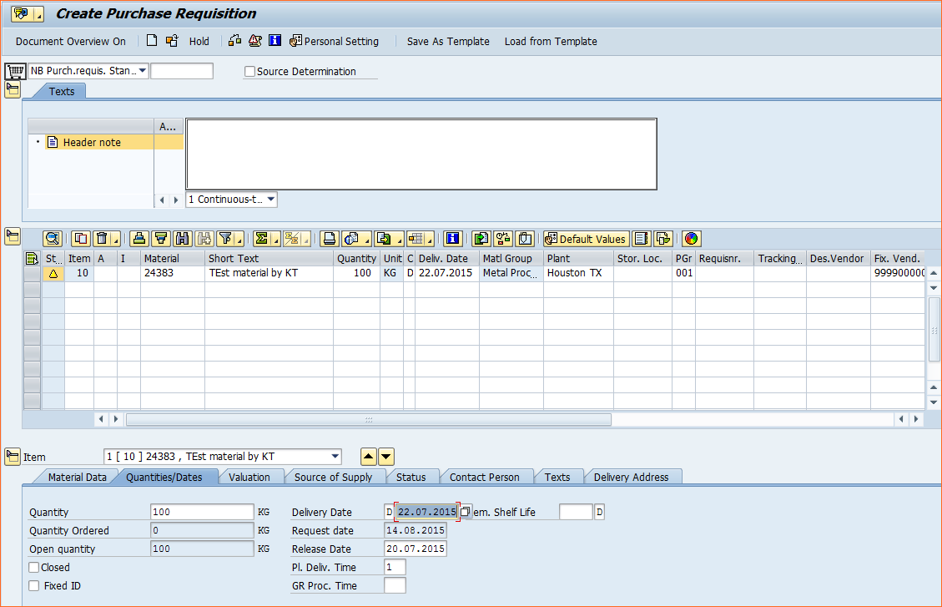
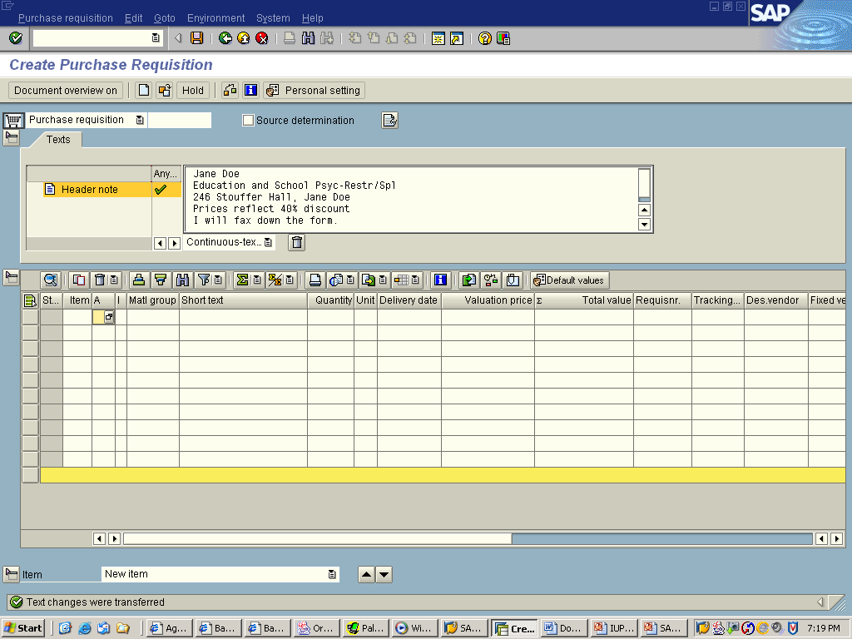
Purchase requisition
The Material Group has a Match List Icon.
1. Click on that Icon.
Material code to be entered here else can be searched for suitable code by clicking on
Note the Delivery Date has been entered in the Delivery Date field..
Notes:
Enter the necessary data in the relevant screen areas. Item overview: E.g. material, quantity, delivery date, and plant If you accidentally entered the wrong material, you can change it without having to create a new item. You can also change the item category and plant without having to create a new item.
Item details: E.g. account assignment and source of supply

Slide 31
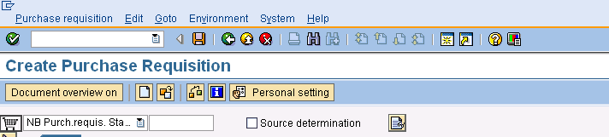
Purchase requisition
1. Click on Check button to find out the all the information entered is accurate
2. Click on Save button.
3. Purchase document created with suitable Document number appears on the status bar

Slide 32
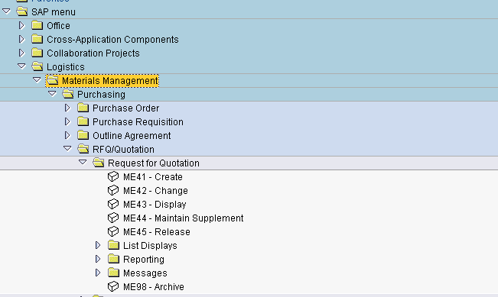
Purchase requisition
Note: When clicked the arrow turns downward.
1. Click on the Logistics arrow button.
2. Click on the Materials Management arrow button.
3. Click on the Purchasing arrow button.
4. Click on the RFQ/Quotation arrow button.
5. Click on the Request for Quotation
6 Double click on Me41 Create line
Notes:
the Purchasing - for RFQ menu, do the following:
...
Log on to the system. The SAP Menu appears.
Choose Logistics -> Materials management - >Purchasing -> RFQ/Quotation - > Request for Quotation , to access Request for Quotation.

Slide 33
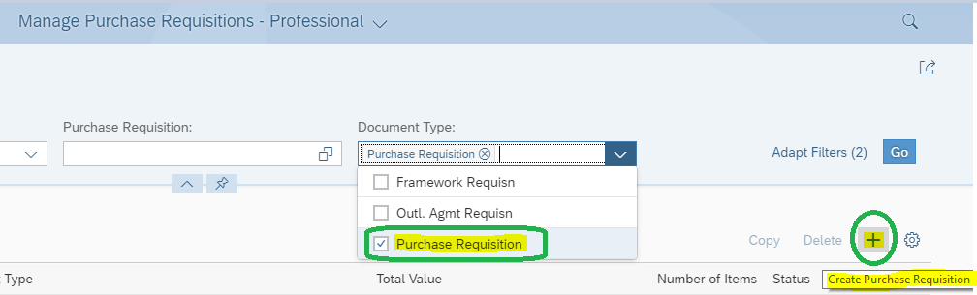
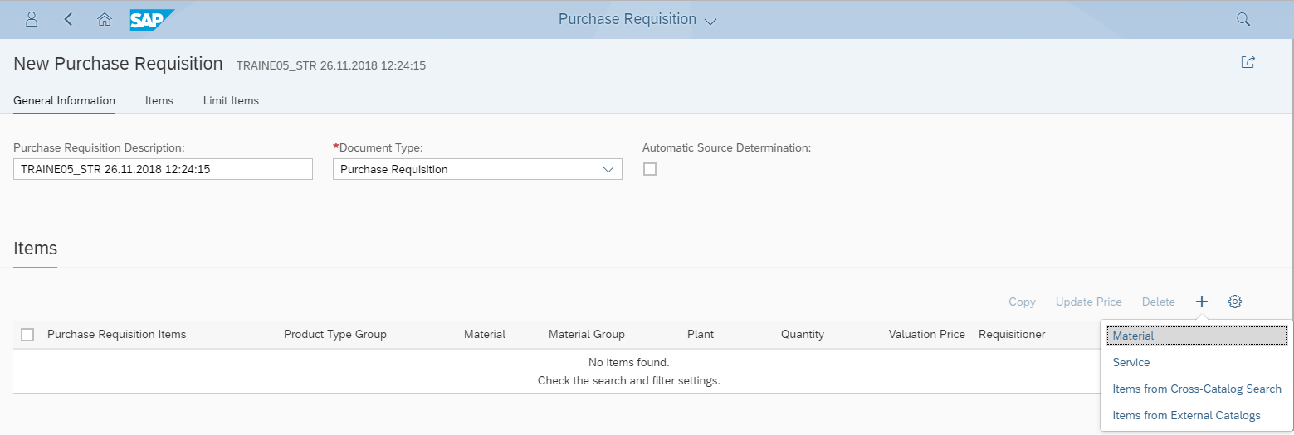
FIORI TILE-Manage Purchase Requisitions-Professional
1. Select Document Type
2. Click on Create (+)
3. Select Material

Slide 34
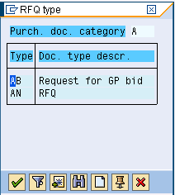
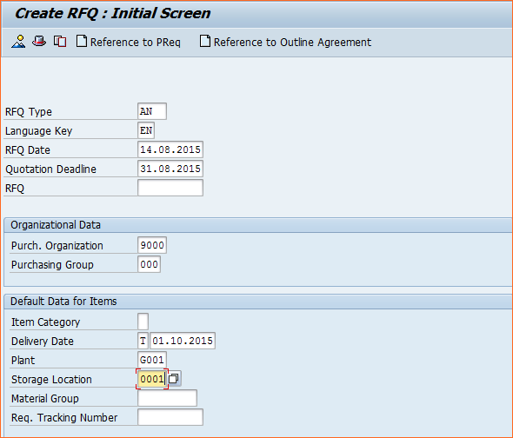
Request for Quotation
1. Choose required one. AN For RFQ
2. Maintain RFQ Date and Quotation Deadline dates
3. Maintain Purchase org details
4. Maintain Desired delivery date should be > Quotation Deadline date
Notes:
A request for quotation (RFQ) is an invitation extended to a vendor by a purchasing organization to submit a quotation (bid) for the supply of materials or performance of services
An RFQ consists of the RFQ header and the items

Slide 35
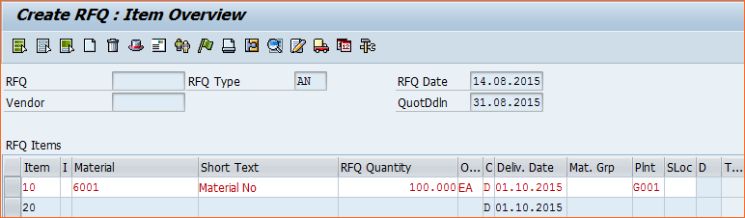
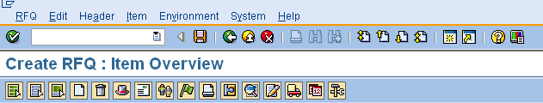
Request for Quotation
1. Material Code is entered here
2. Quantity is entered here
3. Plant code is copied from the initial screen
4. Click on the Address button to maintain Vendor Address to whom the RFQ/Quotation has to be sent
Notes:
Items
Contain the total quantities and delivery dates for the materials or services specified in the RFQ.
An item of a quotation may contain a delivery schedule made up of a number of schedule lines in which the total quantity is broken down into smaller quantities to be delivered on the specified dates over a certain period.
An item of the procurement type "external service" contains a set of service specifications. The latter can be hierarchically structured. The summary view of such a hierarchical structure is referred to as an outline. The outline comprises a number of levels, each representing a level of the service hierarchy. The RFQ quantities are set out in service lines, representing individual jobs or activities.
In contrast to other purchasing documents, you cannot enter an account assignment in an RFQ.

Slide 36
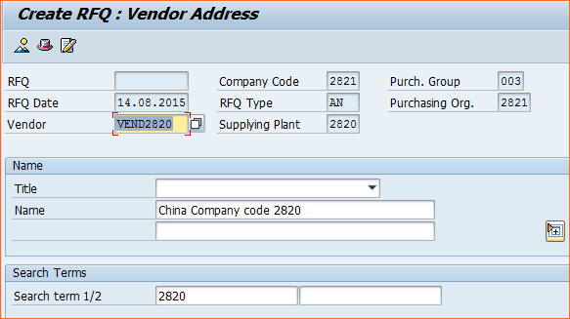
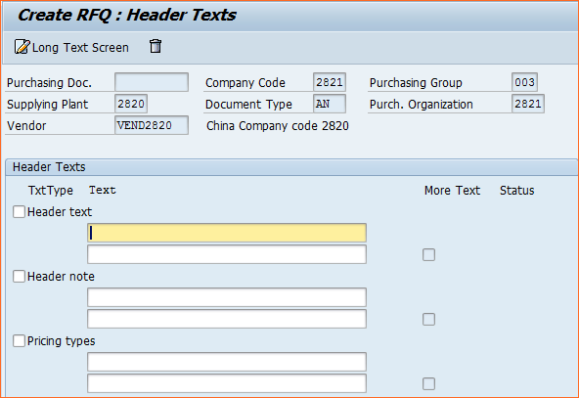
Request for Quotation
1. Vendor code to be entered here
2. In order to maintain any note along with RFQ click on this button
3. Various tests related to pricing, deadline etc can be maintained here

Slide 37
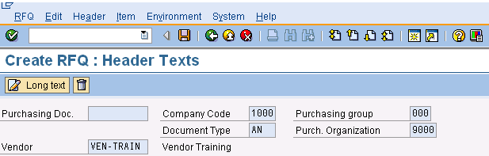
Request for Quotation
1. Click on save button
An RFQ document is Created and system generates an unique number per vendor. Different RFQ Number will be generated for different Vendors

Slide 38
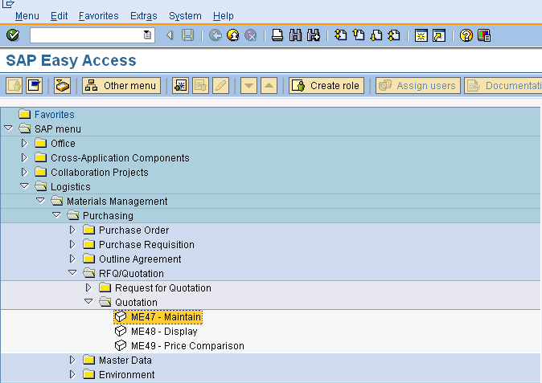
Quotation
Note: When clicked the arrow turns downward.
1. Click on the Logistics arrow button.
2. Click on the Materials Management arrow button.
3. Click on the Purchasing arrow button.
4. Click on the RFQ/Quotation arrow button.
5. Click on the Quotation
6 Double click on Me47 maintain Quotation
Notes:
the Purchasing - for Quotation menu, do the following:
...
Log on to the system. The SAP Menu appears.
Choose Logistics -> Materials management - >Purchasing -> RFQ/Quotation - > Quotation -, to access Quotation.

Slide 39
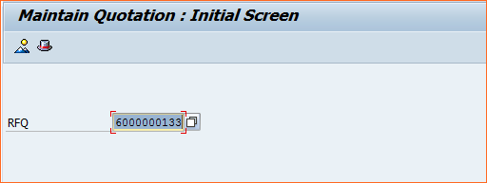
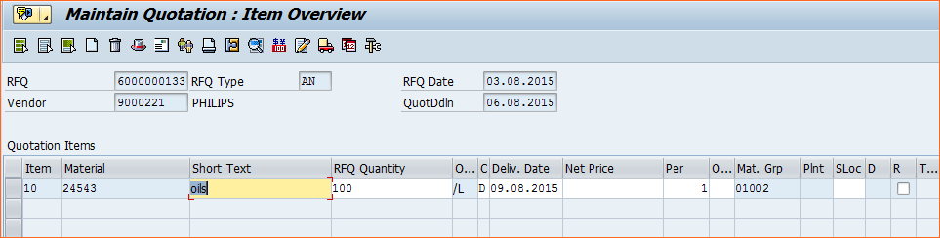

Maintain Quotation
Note: RFQ/Quotation forms single document in SAP. Prices sent by vendors are maintained in Quotations
Enter the Request for Quotation number
Enter the net price as per the price quoted by vendor
Click on Item Condition button to maintain other price elements like duties, taxes, discounts & Surcharges
Notes:
A quotation is an offer by a vendor to a purchasing organization regarding the supply of materials or performance of services subject to specified conditions.
A quotation is legally binding on the vendor for a certain period. The quotation is the vendor’s response to a request for quotation issued by a purchasing organization.
A quotation consists of items in which the total quantity and delivery date of an offered material or service are specified.

Slide 40
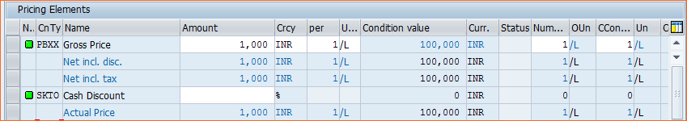
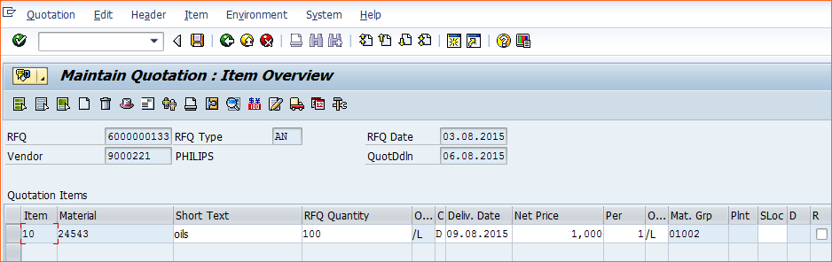
Maintain Quotation
Additional price elements like duties, taxes, discounts & Surcharges is maintained here
Click on back button to go to item overview screen
Click on Save button upon completion
Notes:
Conditions can apply at various levels:
To the entire quotation
At item level, to the material to be supplied or to the planned procurement in the case of services
At service line level for individual services (tasks or activities)

Slide 41
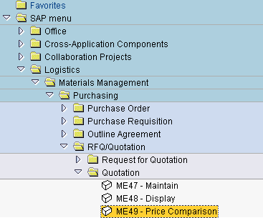
Quotation Price Comparison
Note: When clicked the arrow turns downward.
1. Click on the Logistics arrow button.
2. Click on the Materials Management arrow button.
3. Click on the Purchasing arrow button.
4. Click on the RFQ/Quotation arrow button.
5. Click on the Quotation
6 Double click on ME49 Price Comparison
Notes:
the Purchasing - for Quotation price comparision menu, do the following:
...
Log on to the system. The SAP Menu appears.
Choose Logistics -> Materials management - >Purchasing -> RFQ/Quotation - > Quotation - > Price comparision, to access Price comparision.

Slide 42
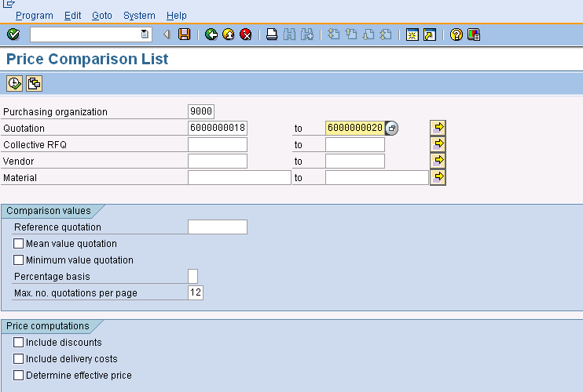
Quotation Price Comparison
1. Enter Purchase org code
2. Enter the quotation number (s) for those price comparison is required
3. Check the required check boxes. This will have a effect if in Quotation one has maintained the delivery costs
Notes:
You can compare the prices from all quotations received as a result of a competitive bidding process using the price comparison list . The comparison list ranks the quotations by item from lowest to highest price.

Slide 43
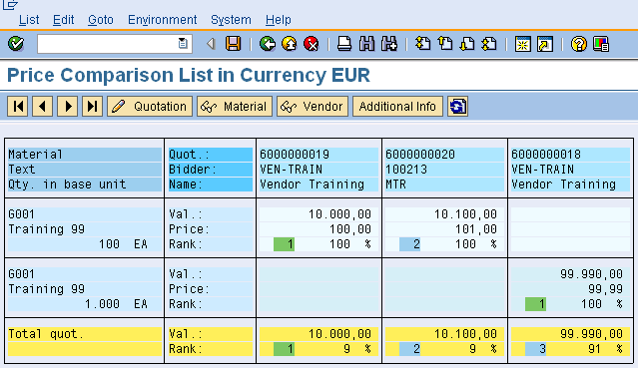
Quotation Price Comparison
Vendor Ranking proposed by the system based on net price comparison
Notes:
The price comparison list displays the price per item in the base unit stored in the material master record.
From the price comparison list, you can do the following:
· Display additional information about the material master record for a particular material
· Display additional information on the quotations in the price comparison
· Display a certain quotation
· Display a vendor master record
· Invoke vendor evaluation functions
If you position the cursor on
- A vendor, only the latter’s evaluation is displayed (in relation to the materials he is able to supply).
- A material, the system generates a ranking list of all vendors that have submitted a quotation.
- T he quotation data (e.g. price or rank), the system will carry out a comparison of evaluations.

Slide 44
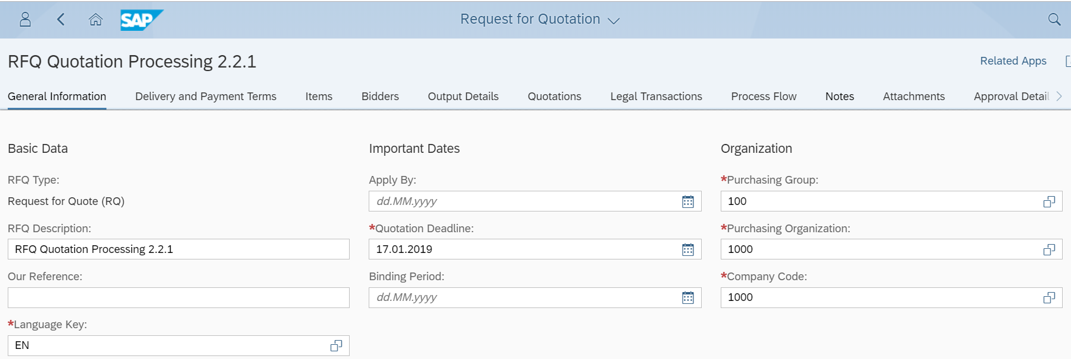
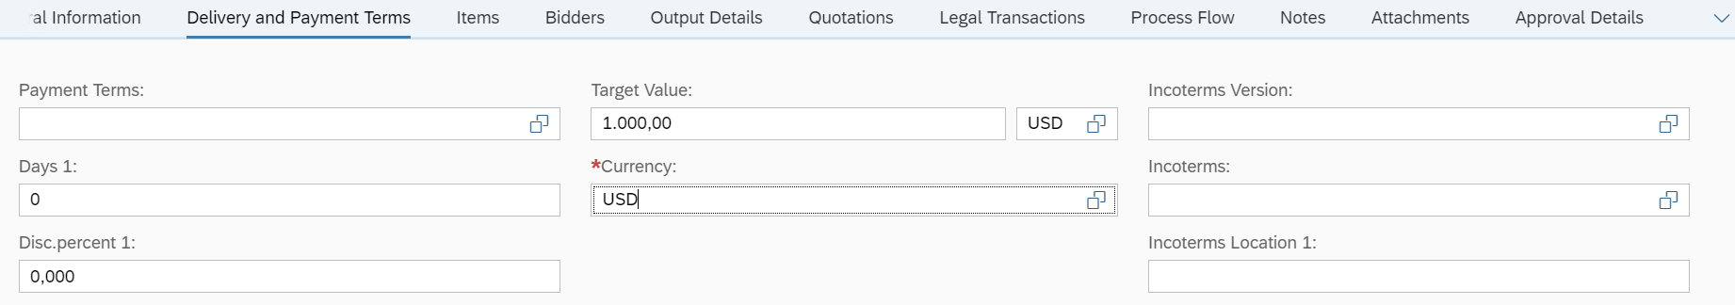
FIORI TILE-Manage Request For Quotation
3.Input Purchase group
2.Input Quotation Deadline
4.Input Purchase Org
5.Input Comp CD
1.Input Language key
6.Input Currency

Slide 45
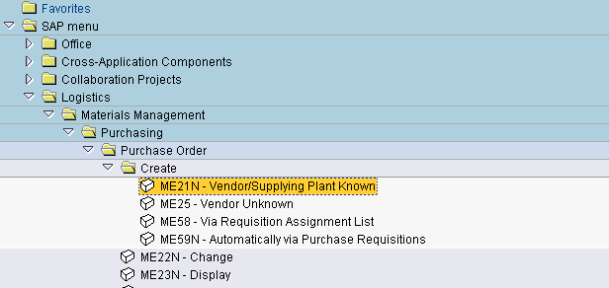
Purchase Order
1. Click on Logistics
2. Click on Materials management
3. Click on Purchasing
4. Click on Purchase order
5. Click on Create
6. Double click on Vendor/supplying plant known
Notes:
the Purchasing menu, do the following:
...
Log on to the system. The SAP Menu appears.
Choose Logistics -> Materials management - >Purchasing, to access the Purchasing menu.

Slide 46
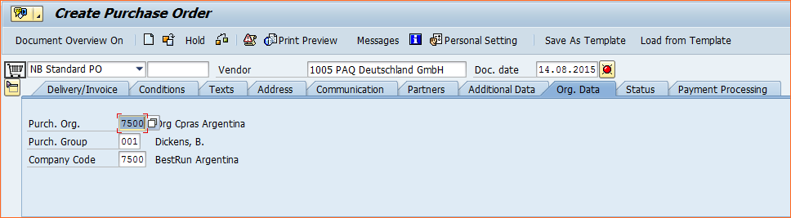
Purchase Order Header
1. Document Type Choose required document type from the drop down
2. Nothing to be mentioned here. Number to be entered In case of External document numbering
3.Vendor code to be entered here
4. System date will be defaulted
5. PO Header related Texts are maintained in this tab
5. Org details like Purchase org, Purchase group and Company code need to mentioned here
6. Payment terms, Incoterms, Exchange rates are all maintained in this tab
Notes:
Each purchasing document is subdivided into two main areas: the header and individual items. Each document will contain a header and can contain several items.
The header contains information relevant to the whole document . The items specify the materials or services to be procured. For example, information about the vendor and the document number is contained in the document header, and the material description and the order quantity are specified in each item.

Slide 47
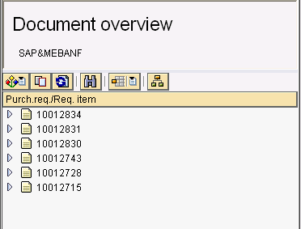
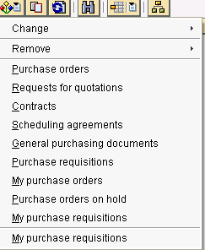
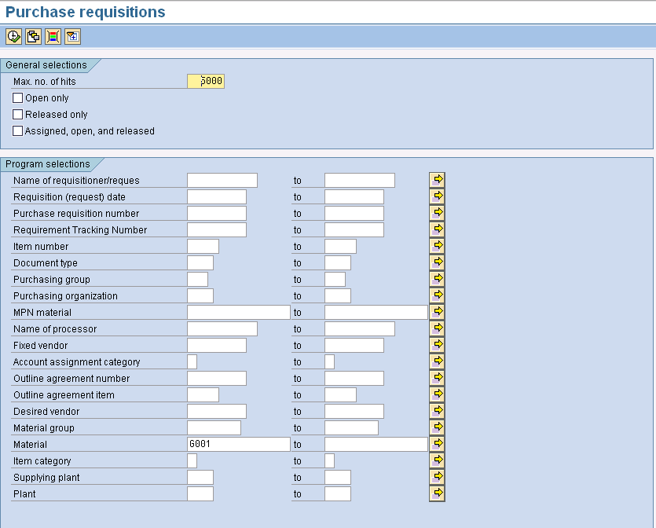
PO Document overview
1. Document overview OFF for closing overview screen On for opening overview screen.
2. Selection variant button and its list
3. Adopt button. Used for copying contents of Purchasing document to Purchase order screen
4.List of documents selected based on the inputs provided in the input screen. User can select the entire document or select lineitems wise and adopt to Purchase order.
5. Various inputs to select required purchasing documents to be adopted to purchase order.
Notes:
In the document overview, you can display different purchasing documents that you need for your daily work (such as requisitions, POs, vendor scheduling agreements, etc.). At the same time, you can work on your requisitions or POs in the right-hand part of the screen.
You can choose which documents are displayed to you in the document overview.
You can display the following documents:
Purchase orders
Requests for quotation
Contracts
Scheduling agreements
Purchasing documents in general
Purchase requisitions
My purchase orders
Purchase Orders on Hold
My purchase requisitions
There are various features in document over view screen which are as mentioned below
Change or Delete Selection Variant, Choose Documents for Processing, Find Documents, Refresh Document Overview, Hide Document Overview

Slide 48
PO Document overview
1. Document overview OFF for closing overview screen On for opening overview screen.
2. Selection variant button and its list
3. Adopt button. Used for copying contents of Purchasing document to Purchase order screen
4.List of documents selected based on the inputs provided in the input screen. User can select the entire document or select lineitems wise and adopt to Purchase order.
5. Various inputs to select required purchasing documents to be adopted to purchase order.
Notes:
In the document overview, you can display different purchasing documents that you need for your daily work (such as requisitions, POs, vendor scheduling agreements, etc.). At the same time, you can work on your requisitions or POs in the right-hand part of the screen.
You can choose which documents are displayed to you in the document overview.
You can display the following documents:
Purchase orders
Requests for quotation
Contracts
Scheduling agreements
Purchasing documents in general
Purchase requisitions
My purchase orders
Purchase Orders on Hold
My purchase requisitions
There are various features in document over view screen which are as mentioned below
Change or Delete Selection Variant, Choose Documents for Processing, Find Documents, Refresh Document Overview, Hide Document Overview

Slide 49
PO Item Over view
1. Item Overview Button in Expanded mode
2. Line item number generated by the system.
5. Plant code is entered here or this data is copied from the referred document
4. Material code, Material text Ordering unit and material group all these information is copied from material master in the event of material master record is referred
3. Account Assignment and Item category are maintained here. Values in these fields are automated based on the document type (at header) choosen
6. Purchase info record is referred by the system while creating PO. This acts a catalyst for faster processing of the document.
7. Tool bar at the right hand bottom of the item overview screen has various buttons for different activities like select/deselect block/unblock sort copy and delete line items,
Notes:
Each purchasing document is subdivided into two main areas: the header and individual items. Each document will contain a header and can contain several items.
Item Overview
The item overview is a summary of the header and item data in a purchasing document. The top part of the item overview screen contains important header data. The center portion of the screen contains data on the items to be procured.
The items are numbered according to the item number increment defined for the document type. You can change the default item number if you wish.
In addition, you can switch between single and double-line display on the item overview screen. To do so, choose Edit -> Change display.

Slide 50
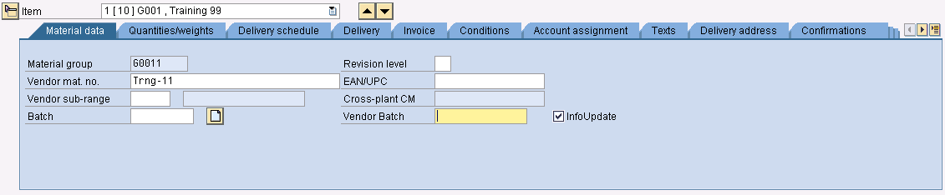
PO Item Detail
1. Item detail Button in Expanded mode
2. Drop down box to navigate among different items or up and down arrow can be used instead
3. Button to navigate among tabs
Notes:
Item Detail Screen
The item detail screen contains important data on the procurement of a material. For example, it shows data for monitoring compliance with due dates and data for controlling goods and invoice receipts.
To display the detailed information on an item, select the item on the overview screen. Then choose Item ->Details
Additional Data on Items
The additional data comprises further information on an item (e.g. prices and conditions, account assignment, texts, etc.). You can display the additional data by selecting the desired item on the item overview screen and choosing the data to be displayed from the Item menu.

Slide 51
Purchasing – Purchase Order
1. Once the data entry is complete. Click on check button to find out whether any necessary information is missed out
2. System will issue a message in the status bar or in a pop up window (based on the settings)
3. Purchase order will be created on saving the document and system will issue a message with document number
Notes:
Check whether data entered is correct by clicking on the check button and save the document. System generates a document number.

Slide 52
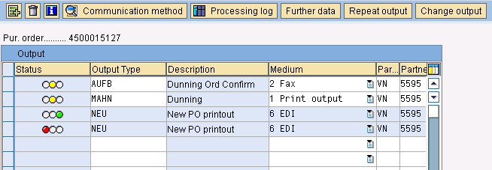
Issuing Messages
Click on the messages button to to set o/p type.
Specifies how the output will be produced.
For e.g fax, Print out put, EDI, mail etc
If the out put has been processed successfully, the traffic light is set to green. If errors occured, it is set to red. Yellow means that the processing program has not been started yet, for example, if the output is also edited manually.
The output type is predefined for your area of the R/3 System. If alternative choices are possible, you can list them by pressing F4 Every Output type will assigned to a medium through which the document has to be transmitted. This is set in configuration setting
Notes:
In order that the purchasing documents you create in the SAP System can be transmitted to the vendor (e.g. via the regular postal service as a normal printed document, as a fax, or via electronic data interchange (EDI)), the system generates a message for each document. (In this context, a message is a document in output format for communication to vendors, and should not be confused with system messages for example. The term "external message" may occasionally be used synonymously in this sense.)

Slide 53
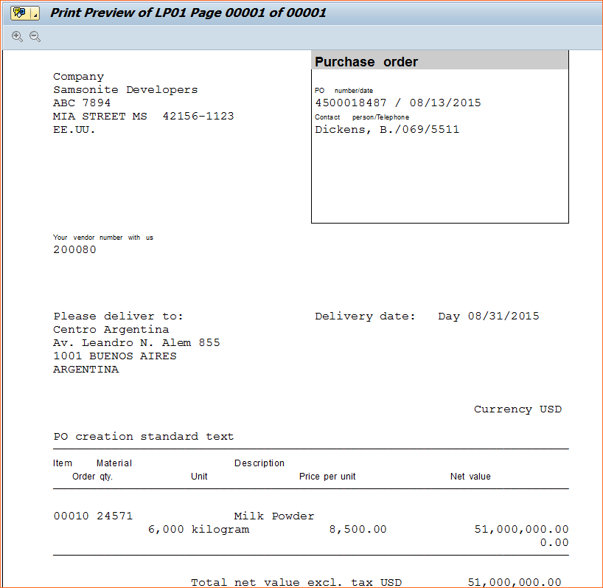
Issuing Messages
A Purchase order Print output sample

Slide 54
Purchasing: Issuing Messages
A Purchase order Print output sample

Slide 55
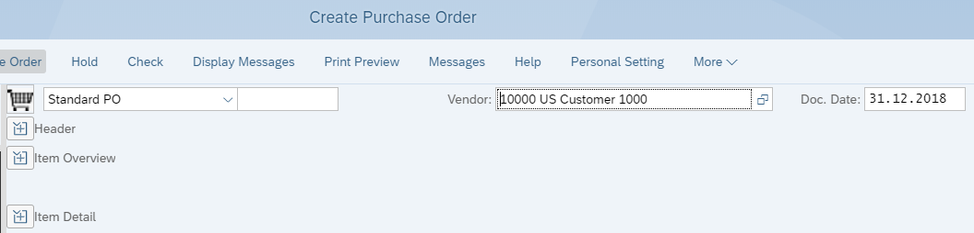
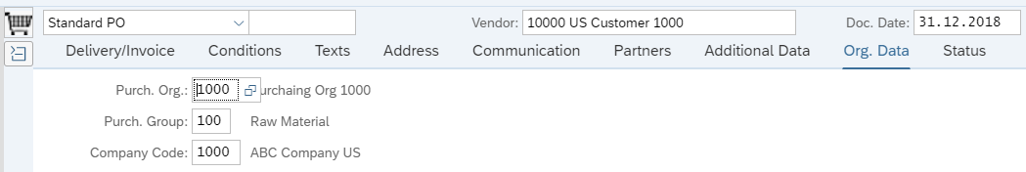
FIORI TILE - Create Purchase Order
2. Click on”+”
1. Input BP in Vendor Field
3. Enter the following Details

Slide 56
Name of the Functionality
PrepareMe
1
2
TellMe
3
ShowMe
4
LetMe
5
HelpMe

Slide 57
Purchasing: Transactions codes
Transaction code | Description
Purchase Requisition
ME51N | Create Purchase Requisition
ME52N | Change Purchase Requisition
ME53N | Display Purchase Requisition
ME5A | Purchase Requisition: List Display
ME5J | Purchase Requisition for Project
ME5K | Requisitions by Account Assignment
MELB | Purchase Requisition by Tracking No
ME54 | Release Purchase Requisition
ME55 | Collective Release of Purchase Requisition
ME5F | Release Reminder: Purchase Requisition
Transaction code | Description
RFQ/Quotation
ME41 | CreateRFQ
ME42 | Change RFQ
ME43 | Display RFQ
ME44 | Maintain supplement
ME45 | Release RFQ
ME4L | List Display RFQ by Vendor
ME4M | List Display RFQ by material
ME4C | List Display RFQ by Material group
ME47 | Quotation Maintain
ME48 | Quotation Display
ME49 | Price Comparison

Slide 58
Purchasing: Transactions codes
Transaction code | Description
Purchase Order
ME21N | Create Purchase Order
ME22N | Change Purchase Order
ME23N | Display Purchase Order
ME2M | Display purchase order by Material
ME2L | Display purchase order by vendor
ME2K | Purchase order by Account Assignment
ME2B | Purchase Order by Tracking No
ME2N | List Display by PO Number
ME29n | Purchase Order Release - Individual
ME28 | Purchase order Release - collective
ME9F | Purchase order Print/Transmit
Transaction code | Description
Contract
ME31K | Create Contract
ME32K | Change Contract
ME33K | Display Contract
ME35K | Release Contract
Scheduling Agreement
ME31L | Create SA
ME32L | Change SA
ME33L | Display SA
ME35L | Release SA

Slide 59
Name of the Functionality
PrepareMe
1
2
TellMe
3
ShowMe
4
LetMe
5
HelpMe

Slide 60
SAP Document settings
Document Property | Purchasing Documents
 | Pur.Req | RFQ | Purchase Order | Contract | SLAs
Doc. Type | B | A | F | K | L
Applicable Item Category | _- Standard, L- Sub-Contracting, K-Consignment, D-Service, S-Third Party Order, U-Stock Transfer, T-Text
A/c Assignment | A-Asset, K-Cost Center, P-Project, C-Sales Order, 1- Third Party Item, U-Unknown, X-Auxiliary A/c. Assignment
CONTROL DATA
1. Document Category | NB - Std. PR / NBB | AN - Std RFQ / ANA AB - Global RFQ/ANA | NB - Std. PO/NBF | MK-Qty/MKK | LP-Std. SA/LPL
/Field Selection Group | FO - Framework PR/FOB |  | FO - Framework PO/FOF | WK-Volume/WKK | LPA-SA with Rel. Doc/LPL
 | RV - OA PR/RVB |  | UB - Stock Transfer PO/UBF | DC-Distributed/WKK | LU-Stock Transfer SA/LUL
 | MV - Model Spec. PR/RVB |  | DB - Dummy PO/NBF
 | IN - E Commerce PR/NBB |  | IN - E Commerce PO/NBF
2. Number Ranges | Yes. OMH7 | Yes. OMH6 | Yes. OMH6 | Yes. OMH6 | Yes. OMH6
a) Internal/External | Yes. 01/02 | Yes.60/61 | Yes. 45/41 | Yes. 46/44 & DC-70 | Yes. 55/56
b) Same/Different | Yes. | Yes. | Yes. | Yes. | Yes.
3. Screen Layout | Yes | Yes. | Yes. | Yes. | Yes.
4. Document Types | Yes | Yes. | Yes. | Yes. | Yes.
5. Texts | Yes | Yes. | Yes. | Yes. | Yes.
6. Release Procedure | Yes | Yes | Yes. | Yes. | Yes.
7. Tolerance Limit for Archiving | Yes | Yes. | Yes. | Yes.* | Yes.*
8.Set Up Authorization Check for G/L Accounts | Yes. | No | Yes. | Yes. | Yes.

Slide 61
Additional Information: List of Tables (need to replace with Hana tables, required help on this)
Table | Table Description | Table | Table Description
EINA | Purchasing Info Record- General Data | MARA | Material master
EINE | Purchasing Info Record- Purchasing Organization Data | MAKT | Material text
MAKT | Material Descriptions | MARC | Material per plant / stock
MARA | General Material Data | MVKE | Material master, sales data
MARC | Plant Data for Material | MARD | Storage location / stock
MARD | Storage Location Data for Material | MSKA | Sales order stock
MAST | Material to BOM Link | MSPR | Project stock
MBEW | Material Valuation | MARM | Units of measure
MKPF | Header- Material Document | MEAN | international article number
MSEG | Document Segment- Material | PGMI | Planning material
MVER | Material Consumption | PROP | Forecast parameters
MVKE | Sales Data for materials | MAPR | Link MARC <=> PROP
RKPF | Document Header- Reservation | MBEW | Material valuation
T023 | Mat. groups | MVER | Material consumption
T024 | Purchasing Groups | MLGN | Material / Warehouse number
T156 | Movement Type | MLGT | Material / Storage type
T157H | Help Texts for Movement Types | MPRP | Forecast profiles

Slide 62
Additional Information: List of Tables, need help on this
Table | Table Description | Table | Table Description
MOFF | Lists what views have not been created | MDTB | MRP table
A501 | Plant/Material | MDKP | Header data for MRP document
EBAN | Purchase Requisition | MLAN | Tax data material master
EBKN | Purchase Requisition Account Assignment | MTQSS | Material master view: QM
EKAB | Release Documentation | EKKO | Purchase document
EKBE | History per Purchasing Document | EKPO | Purchase document (item level)
EKET | Scheduling Agreement Schedule Lines | EKPV: | Shipping-Specific Data on Stock Tfr. for Purch. Doc. Item
EKKN | Account Assignment in Purchasing Document | EKET | Delivery schedule
EKKO | Purchasing Document Header | VETVG | Delivery Due Index for Stock Transfer
EKPO | Purchasing Document Item | EKES | Order Acceptance/Fulfillment Confirmations
IKPF | Header- Physical Inventory Document | EKKN | Account assignment in purchasing
ISEG | Physical Inventory Document Items | EKAN: | Vendor address purchasing
LFA1 | Vendor Master (General section) | EKPA | Partner functions
LFB1 | Vendor Master (Company Code) | EIPO | Item export / import data
NRIV | Number range intervals | EINA | Purchase info record (main data)
RESB | Reservation/dependent requirements | EINE | Purchase info record (organizational data)
T161T | Texts for Purchasing Document Types | EORD | Source list
EBKN | Purchase Requisition Account Assignment | EBAN | Purchase requisition

Slide 63
Case Study- Create purchase order.
1. Create a purchase order with the following header data:
Vendor T-K520A##
Purchasing organization 1000 (IDES Deutschland)
Purchasing group Z## (SCM520-##)
Company code 1000 (IDES AG)
Item 1:
20 boxes of material T-M520C## are needed in plant 1000. Choose account
assignment category K for cost center and assign the purchase to G/L account 400000 and cost center 1000.
Must you enter an order price?
_________________________________________________
_________________________________________________
Where does the default value for the delivery date come from?
_________________________________________________
_________________________________________________

Slide 64
Test Your Knowledge
1. How do scheduling agreements differ from contracts?
Choose the correct answer(s).
□ A You can create contracts with reference to a scheduling agreement
but you cannot create scheduling agreements with reference to a contract.
□ B Account assignment category U (unknown) is allowed in the contract but not in the scheduling agreement.
□ C Contracts can contain a plant but scheduling agreements have to.
□ D You can use item category W (material group) in both the contract and the scheduling agreement but you can only use item category M (material unknown) in the contract.
2. You want to create a purchase order but do not know the vendor. Which statement is applicable? Choose the correct answer(s).
□ A You have to first create a requisition.
□ B You create a purchase order without a vendor, hold this and then assign a source to the purchase order using a collective transaction.
□ C Using the "Create PO, vendor unknown" function.
□ D You always have to use a one-time vendor.

Slide 65
Test Your Knowledge
3. No source was found in the assignment list during automatic assignment of sources. What can you do?
Choose the correct answer(s).
□ A Assign a source manually.
□ B Flag the purchase requisition for RFQ.
□ C Convert the purchase requisition directly to an RFQ to a 1-time vendor.
□ D Block the purchase requisition automatically.
4. What identifies a subcontracting item in a purchase order?
Choose the correct answer(s).
□ A Item category for subcontracting
□ B An account assignment category must also be used in conjunction
with the subcontracting item category.
□ C One component at minimum must be provided.
□ D The material ordered and material provided can be identical.

Slide 66
Answers
How do scheduling agreements differ from contracts?
Answer: B, C.
2. You want to create a purchase order but do not know the vendor. Which
statement is applicable?
Answer: C
3. No source was found in the assignment list during automatic assignment of
sources. What can you do?
Answer: A, B
During manual assignment, the system checks whether there is a
corresponding info record. A warning message is output in the standard system if an info record does not exist (Message 06341). Is this is set up as an error message, a purchasing info record must be available for the fixed vendor being entered. Flagging the RFQ (answer B) is only possible in the "Assign and Process" transaction (ME57).
3. What identifies a subcontracting item in a purchase order?
Answer: A, C, D
The material ordered can be identical with the material provided (answer D). This is known as recursion.

